Slide 1




Online Food Delivery System
"A Java-Based Application for Efficient Restaurant Management, Order Processing, and Automated Billing Using Object-Oriented Programming Concepts."

Slide 2

Introduction
Online food ordering platforms connect customers with restaurants and streamline order fulfilment. This project implements a compact, console-based Online Food Delivery System using Java to model restaurant operations, orders and automated billing
Purpose
Demonstrate practical application of Java OOP to manage restaurants, menus and orders.
Need
Efficient order management reduces manual errors and speeds up billing for small restaurants.
Objectives
Implement Java and OOP concepts
Manage restaurants, food items, and customer orders
Calculate bills automatically
Generate clear order summaries

Slide 3

System Workflow
Browse Menu
The flowchart shows the customer journey from browsing the menu to receiving a final bill. Business rules (delivery charge, tax) are applied automatically before finalising the order.
Select items
Add Quantity
Create Order
Main classes
Restaurant Class — stores menu and restaurant details
FoodItem Class — name, price, category
Order Class — selected items, quantities, billing logic
Key OOP Concepts
Classes & Objects
Encapsulation (private fields, getters/setters)
Constructors &Method design

Slide 4
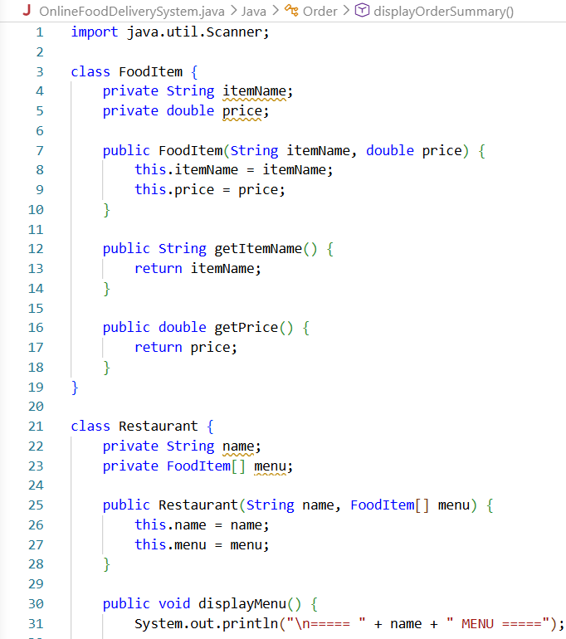
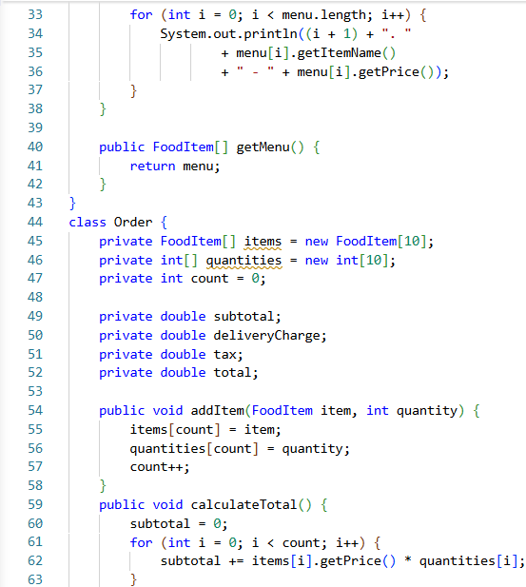
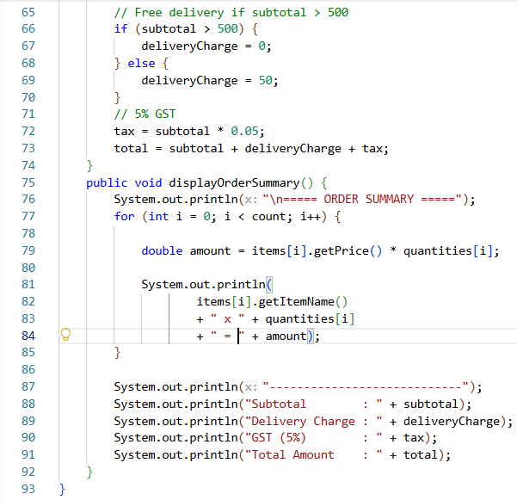
Project — Menu & Food Selection (Screenshot)

Slide 5
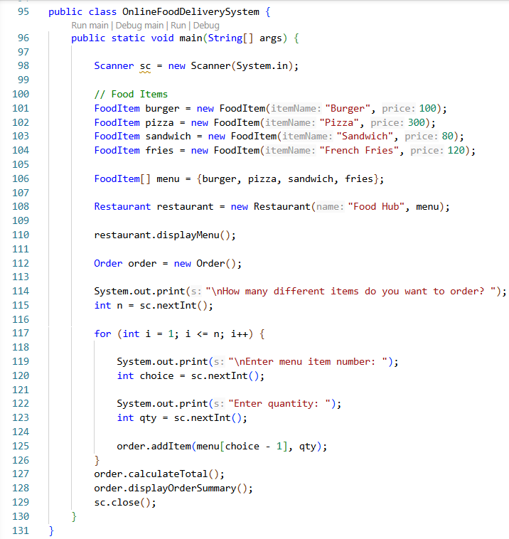
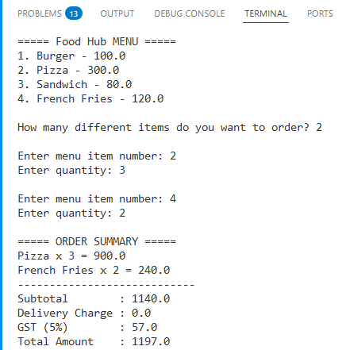
Output:-
Order summary lists selected items and quantities, calculates subtotal, adds delivery charges and GST, then displays the final payable amount. The system also generates a concise order receipt for record-keeping.
Subtotal computed from item prices and quantities
Delivery charges applied as a fixed or conditional fee
GST/Tax applied as percentage
Final bill presented with breakdown

Slide 6
Conclusion
Learning Achieved
Applied classes, encapsulation, constructors and methods in a practical context.
Functional Highlights
Automated billing, order summaries and simple menu management validated through screenshots and tests.
Project Outcome
Successful implementation of an Online Food Delivery System using Java with clear OOP structure.

Slide 7






Future Scope
Multiple Restaurants
Extend model to host several restaurants with independent menus.
Coupon System
Introduce discount codes and validation rules.
Database Integration
Migrate data to MySQL for persistence and reporting.
Distance-Based Charges
Calculate delivery fee by distance and ETA.
User Accounts
Implement registration, authentication and order history.
GUI & Web/Mobile
Build Java Swing GUI and later a web or mobile frontend.

Slide 8
Thank You

